Slide 1
Android Boot Camp for Developers Using Java, 3E
Chapter 4: Explore! Icons and Decision-Making Controls

Slide 2
Objectives
In this chapter, you learn to:
Create an Android project with a custom icon
Change the text color in controls using hexadecimal colors
Align controls using the gravity properties
Determine layout with the layout:margin properties
Place a RadioGroup and RadioButtons in Android applications
Write code for a RadioGroup control

Slide 3
Objectives (continued)
Make decisions using an If statement
Make decisions using an If Else statement
Make decisions using logical operators
Display an Android toast notification
Test the isChecked property
Make decisions using nested if statements

Slide 4
The Medical Calculator App
We will be creating an app to convert pounds to kilograms and kilograms to pounds
Formulas needed:
Kilograms = pounds * 2.2
Pounds = kilograms / 2.2
App is designed to be used in a hospital setting to administer medication to patients based on patient weight
Hospital scales register pounds
Meds (based on patient weight) dispensed in kilograms

Slide 5
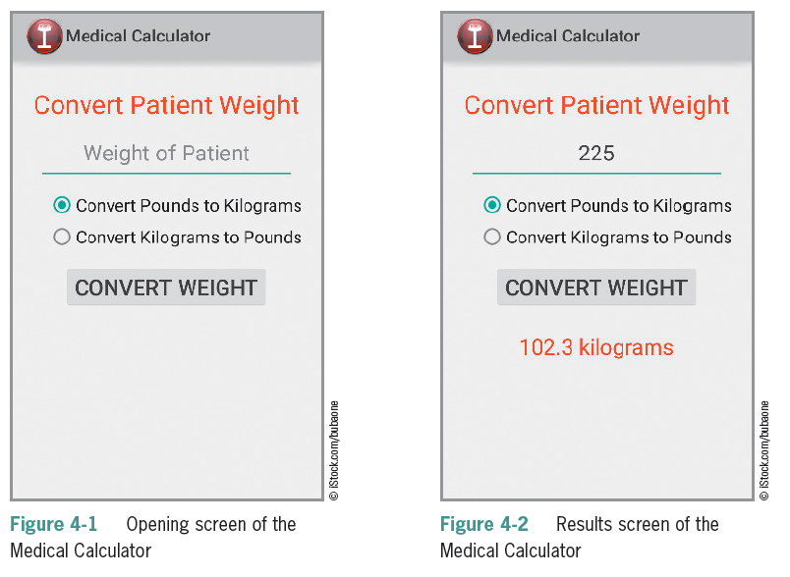
The Medical Calculator App (continued)

Slide 6
The Medical Calculator App (continued)
Steps to complete the App
Create a customized launcher icon.
Add the icon using code to display in the ActionBar.
Define a TextField for the data entry of the weight of the patient.
Define a RadioGroup to select pounds to kilograms or kilograms to pounds.
Display a Toast message for data validation.
Convert data so it can be used for arithmetic operations.
Perform arithmetic operations on data the user enters.
Display formatted results.

Slide 7
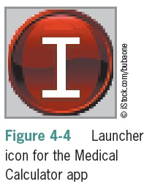
The Launcher Icon
The Launcher Icon allows you to view which apps are available
High-quality launcher icons can influence users to purchase your app
Icons can establish brand identity
Simple images with clear visual cues have a memorable impact
Icon dimensions are 72 X 72 pixels for the high-density screen
Vector graphics as best for icon design because images are easily resized

Slide 8
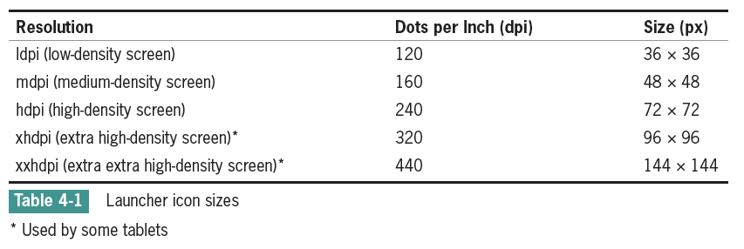
The Launcher Icon (continued)
When you publish an app to the Android Market, you must provide a 512 × 512 pixel, high-resolution application icon in the developer console as you upload your program. This icon is displayed in the Android Market to provide a description of the app and does not replace your launcher icon.

Slide 9
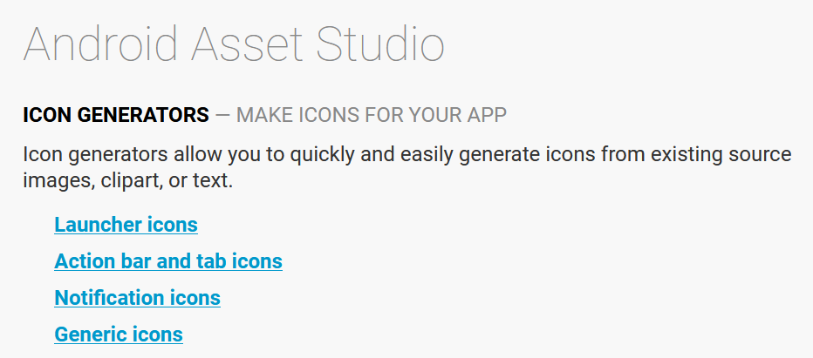
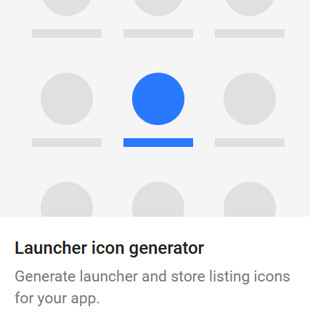
Websites for Creating Icons
https://jgilfelt.github.io/AndroidAssetStudio/
https://romannurik.github.io/AndroidAssetStudio/index.html

Slide 10
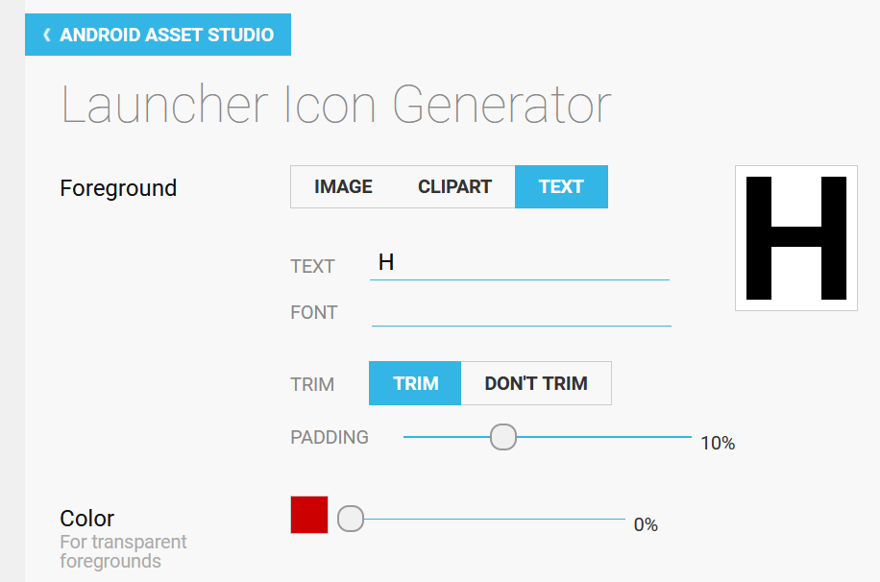
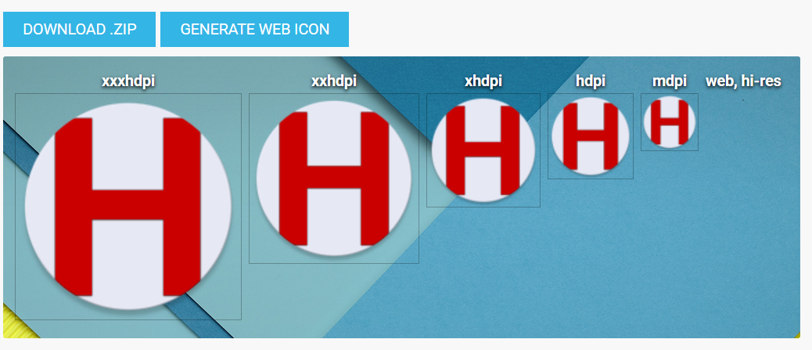
Creating an icon from Text

Slide 11
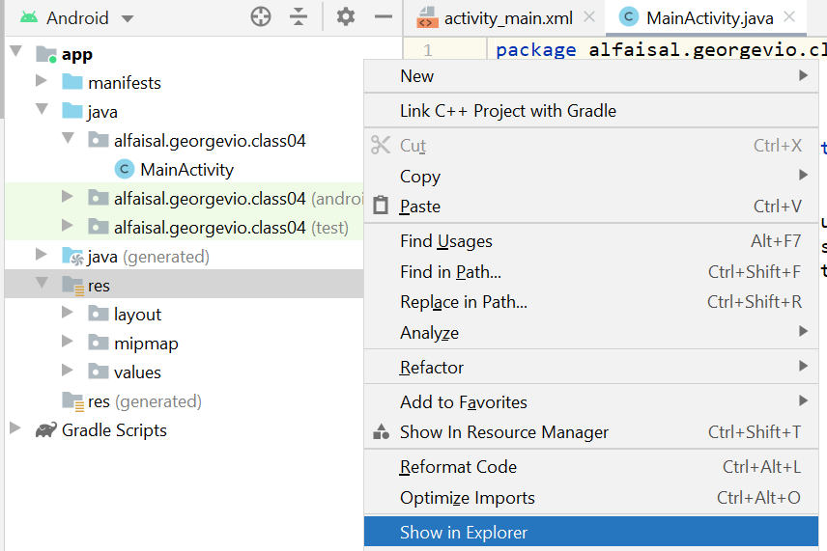
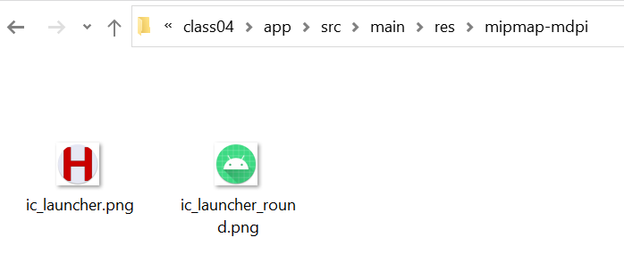

Slide 12
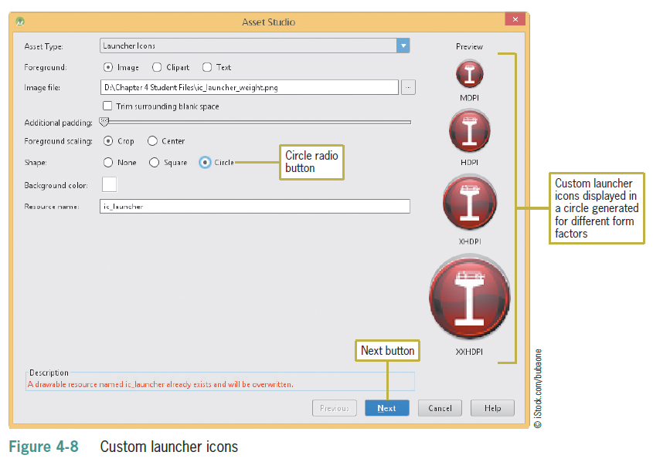
The Launcher Icon (continued)
Customizing a Launcher Icon

Slide 13
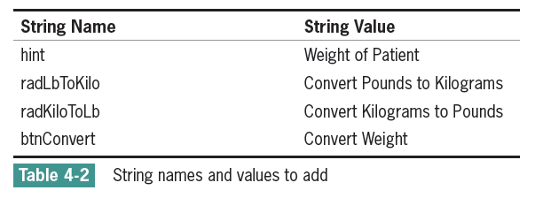
String Table
String resources are stored within the /res/values/strings.xml file
Any strings you add to the strings.xml file are accessible within your application

Slide 14
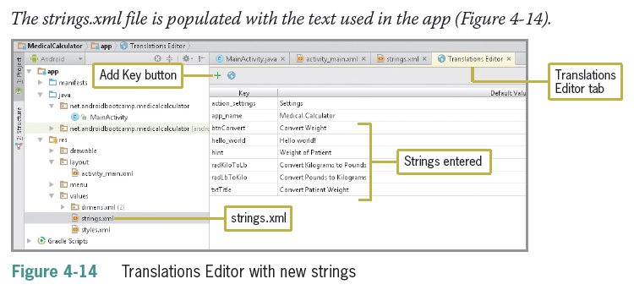
String Table (continued)

Slide 15
RadioButton and RadioGroup Controls
A RadioButton control selects or deselects an option
Can be arranged horizontally or vertically
Have a label defined by the text property
Can be initially set to checked or unchecked
Typically used together in a RadioGroup
Only one RadioButton in the group can be selected at a time
Good to offer a default selection (checked = true) for the option that is used most

Slide 16
Changing the Text Color of Android Controls
Use hexadecimal color codes to represent RGB (Red, Green, Blue) values
Codes range from 00 to FF (00 = none, FF = full)
Codes are identified by a pound sign, followed by the RGB values
#FF0000 is all RED
#00FF00 is all GREEN
#0000FF is all BLUE
#FFFF00 is YELLOW (RED and GREEN = YELLOW)

Slide 17
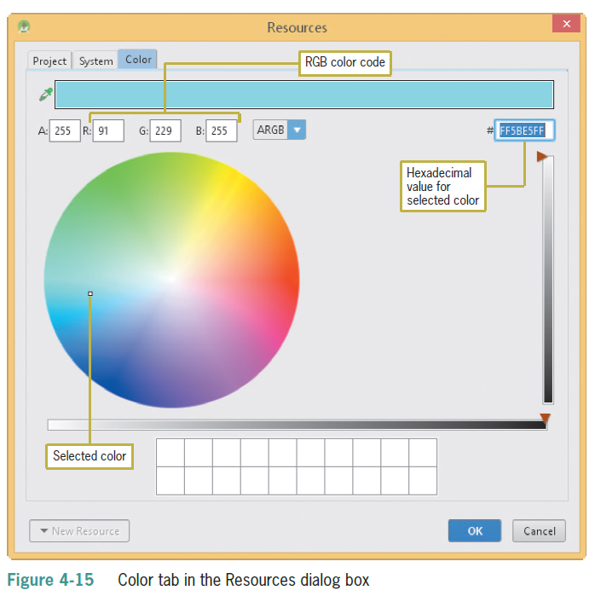
Changing the Text Color of Android Controls (continued)

Slide 18
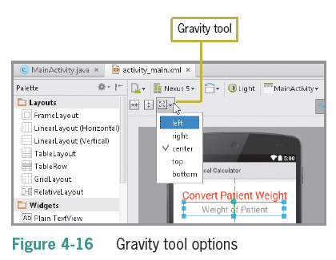
Changing Margins and Layout Gravity
Changing the Margins
Layout:margin allows for more flexibility in controlling your layout
Set independent pixel values instead of “eyeballing” to create equal spaces around controls
Using the same specified margins creates a symmetrical layout
Changing the Layout Gravity
Linear layout is the default setting on the emulator
The Gravity tool changes the alignment
Works like the left, center, right, top or bottom buttons on the Microsoft Office ribbon

Slide 19
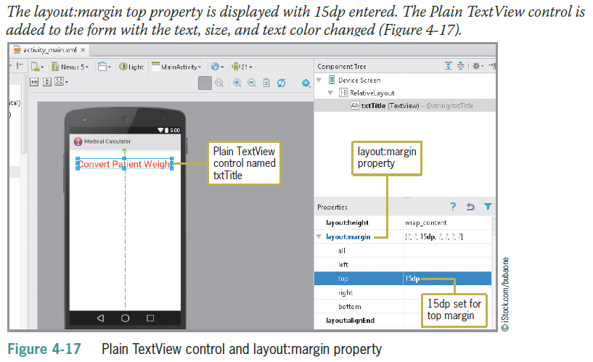
Adding the RadioButton Group
Use the prefix rad to name the control

Slide 20
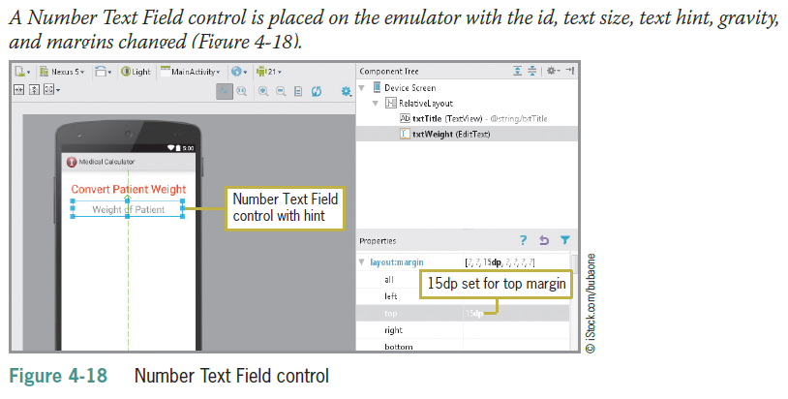
Adding the RadioButton Group (continued)

Slide 21
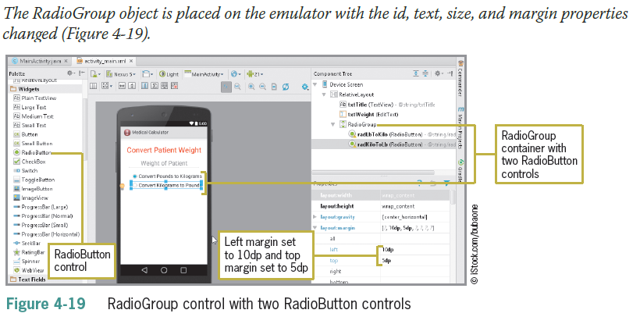
Adding the RadioButton Group (continued)

Slide 22
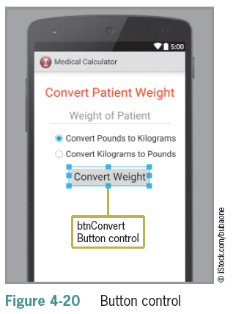
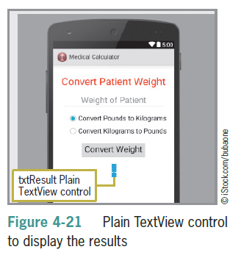
Completing the User Interface

Slide 23

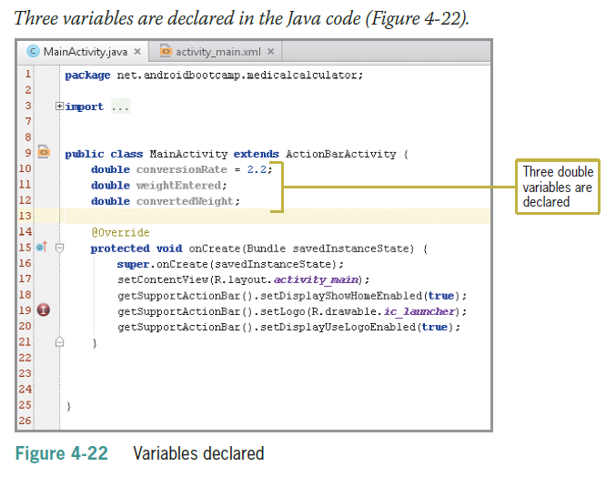
Coding a RadioButton Control
Deprecated

Slide 24
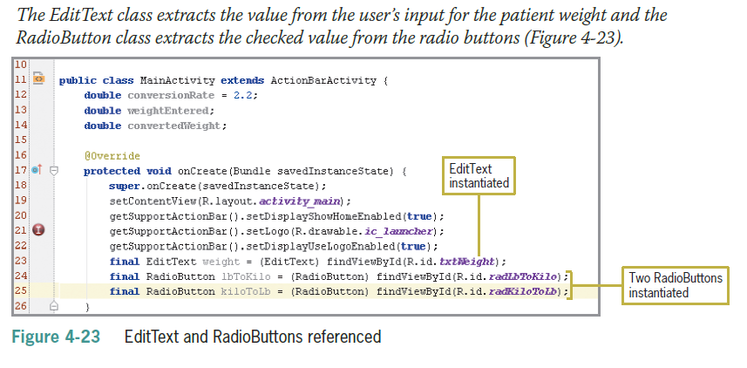
Coding a RadioButton Control (continued)
Deprecated

Slide 25
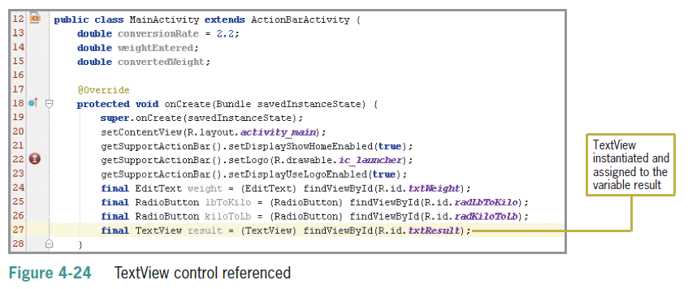
Coding the Button Control

Slide 26
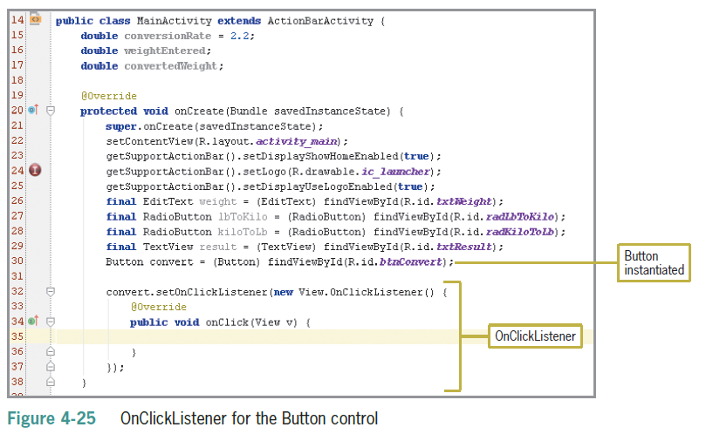
Coding the Button Control (continued)

Slide 27
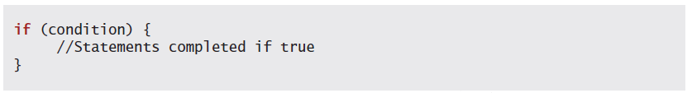
Making Decisions with Conditional Statements
Decision structures are used to test conditions
Using an If Statement
Statements between the opening and closing braces are executed if the condition is true

Slide 28
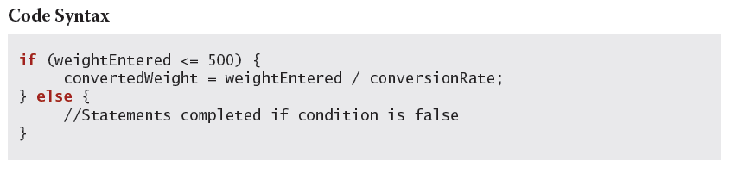
Using If Else Statements
One set of statements are executed if the condition is true and a different set of statements are executed if the condition is false

Slide 29
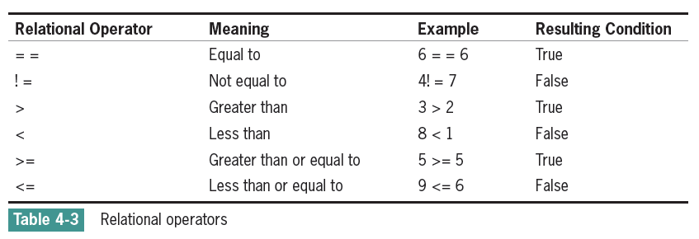
Relational Operators
Java strings are compared with the equals method (==) of the string class

Slide 30
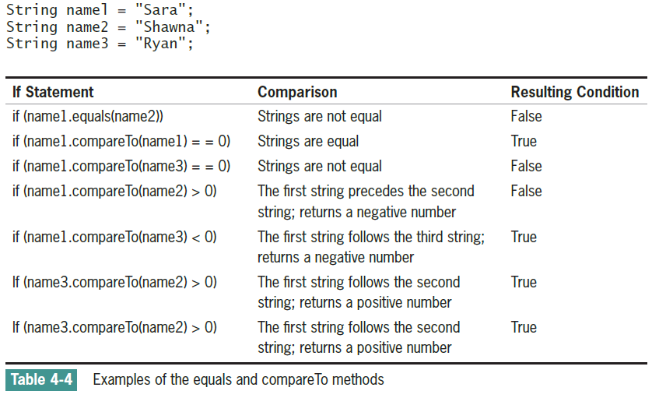
Relational Operators (continued)

Slide 31
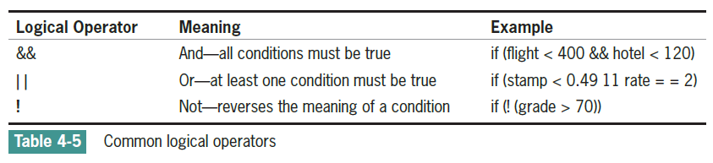
Logical Operators
When more than one condition is tested the conditions are called a compound condition

Slide 32
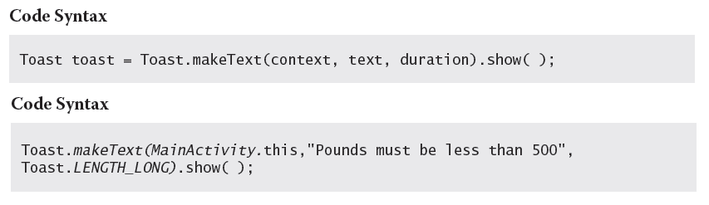
Data Validation and Toast Notifications
Data Validation
User entries must be checked for reasonable values
Toast Notification
A toast notification communicates messages to the user (message slides upward into view like toast popping out of a toaster)

Slide 33
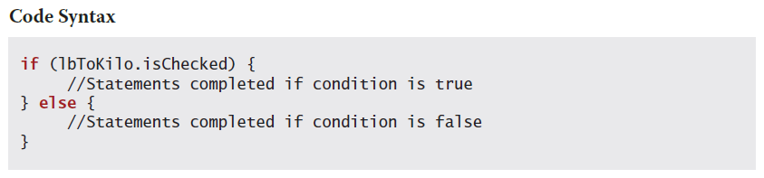
Using the isChecked() Method of RadioButton Controls
The isChecked() method determines if the RadioButton object has been selected

Slide 34
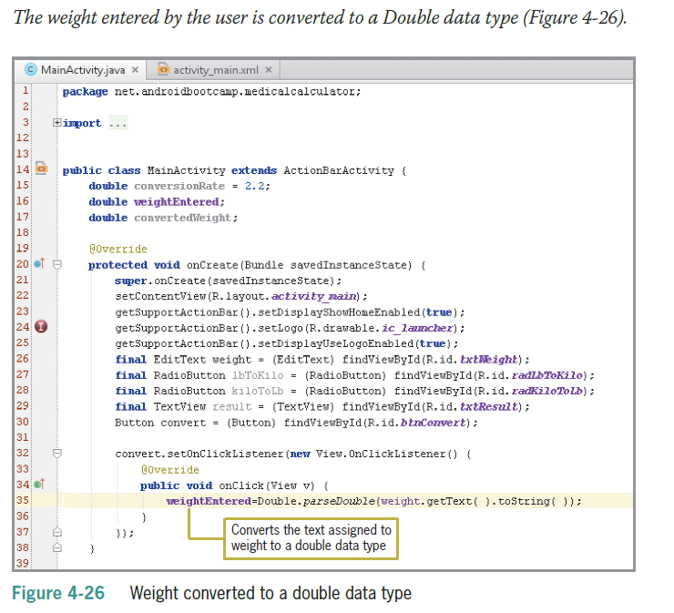
Coding the Button Event
The syntax Double.parseDouble converts input to a Double data type and Integer.parseInt converts input to an Integer data type

Slide 35
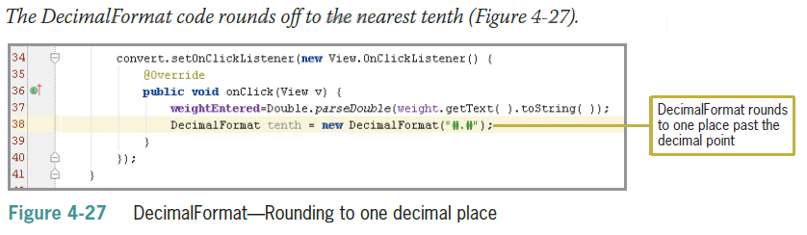
Coding the Button Event (continued)

Slide 36
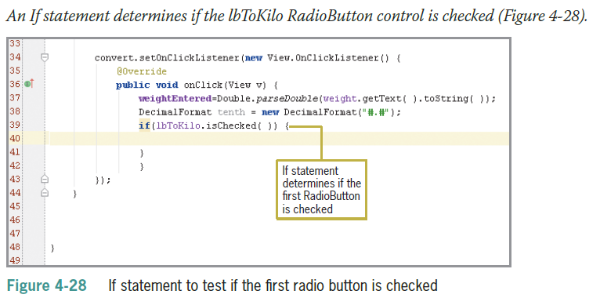
Coding the Nested If Statements
If statements are nested when one if statement is inside of another if statement

Slide 37
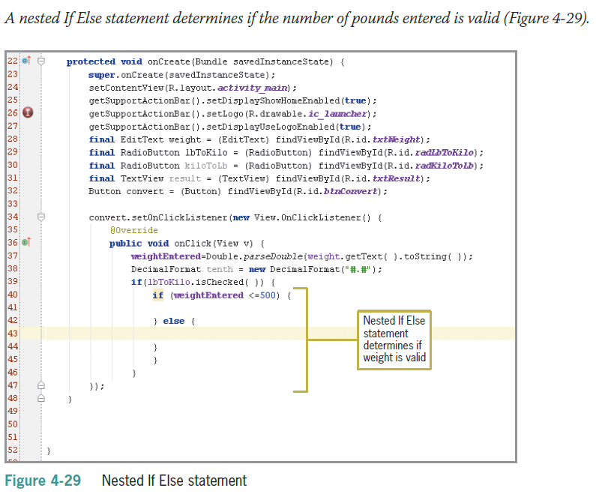
Coding the Nested If Statements (continued)

Slide 38
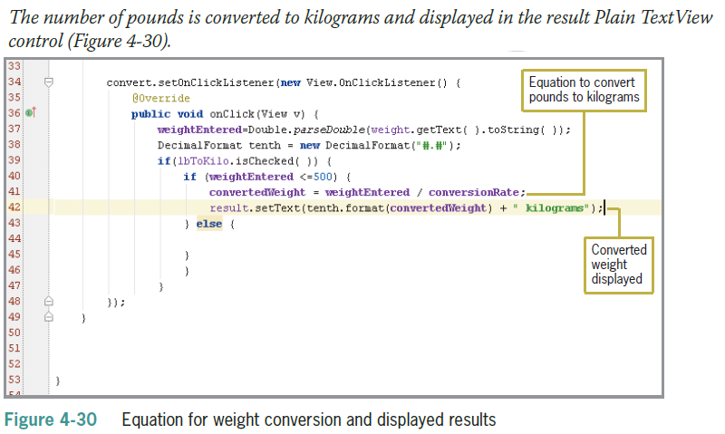
Coding the Nested If Statements (continued)

Slide 39
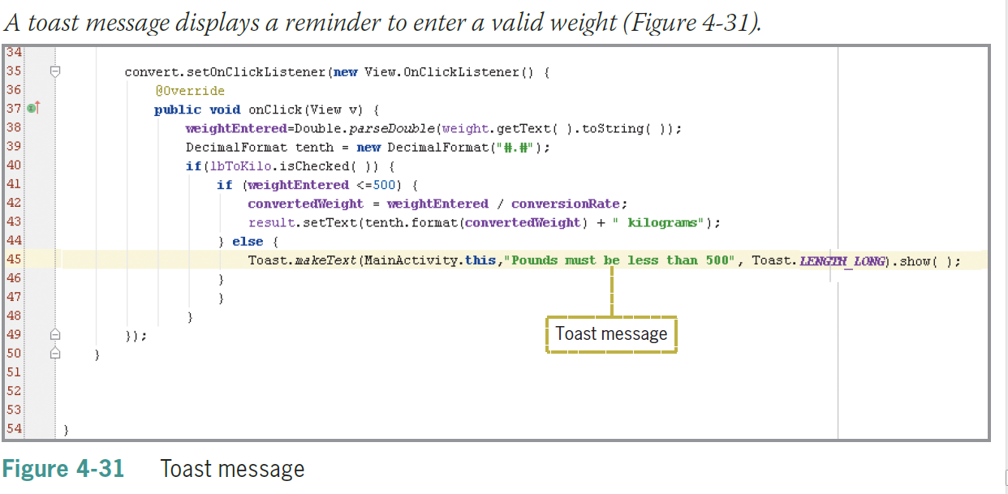
Coding the Nested If Statements (continued)

Slide 40
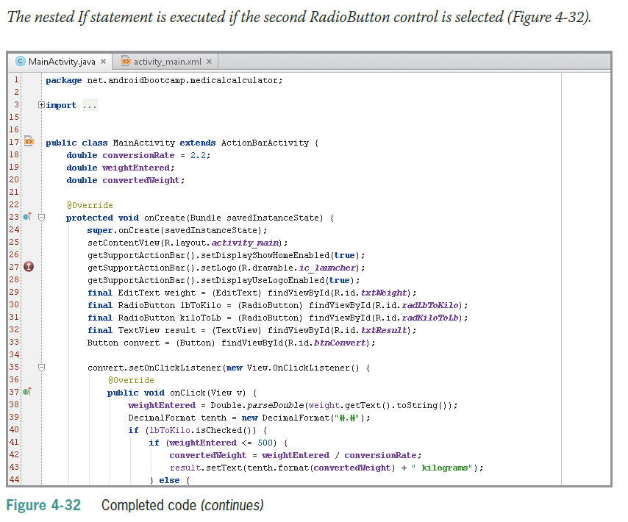
Coding the Nested If Statements (continued)

Slide 41
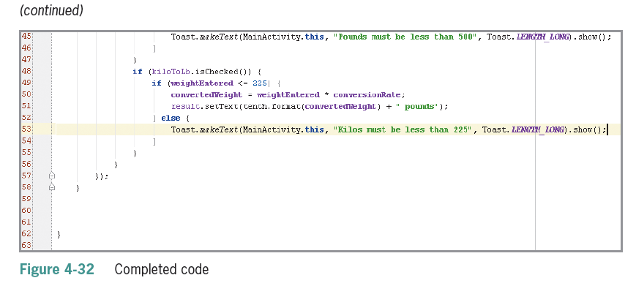
Coding the Nested If Statements (continued)

Slide 42
Summary
To display a custom launcher icon instead of the default icon on the home screen of an Android device, tap or click Image Asset on the New menu to open the Asset Studio dialog box
Include RadioButton controls to allow users to select or deselect options – only one button can be selected at a time
Android apps use hexadecimal color codes
Use the layout:margin property to change the spacing between objects

Slide 43
Summary (continued)
If statements execute statements if a condition is true
If Else statements execute one group of statements if a condition is true and different group of statements if the condition is false
Relational operators are used within the conditional statement
Compound conditions must use logical operators such as && (And)

Slide 44
Summary (continued)
Toast notifications display a brief message to a user
Use nested If statements to test a second condition only after determining that a first condition is true or false

